Slide 1
Group 11
Distributed Applications

Slide 2
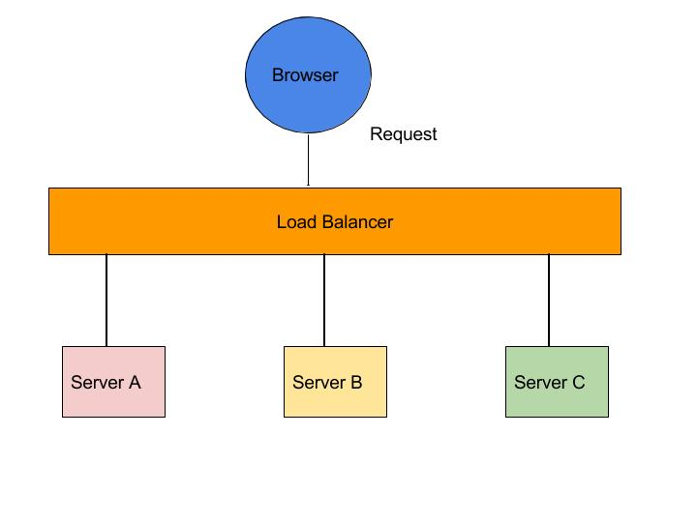
Role of load balancers in distributed applications
balances the payload among multiple instances of a service.
It distributes the work load of your system to multiple individual system, which in turn increases the reliability, efficiency and availability of your application or website.

Slide 3
Software load balancers:
implement one or more scheduling algorithms; there can also be hybrids of the following three:
Weighted scheduling algorithms: Request will be assigned to the server based on its weight. This weight is determined by the administrators wisely by considering the hardware capabilities of each server. The LB will computer the percentage of traffic to be sent to a particular server according to the weight assigned to it.
Round robin: Request are severed server by server sequentially one after another. Once the last server is reached, it starts from the first server again.
3. Least connection first scheduling: Request are served first to the server which is currently handling least number of persistent connections.
SW LB are often installed on the servers and consumes processor and memory of the servers.
Examples of SW LB are HAproxy, NGINX, mod Athens, Varnish, Balance, LVS

Slide 4
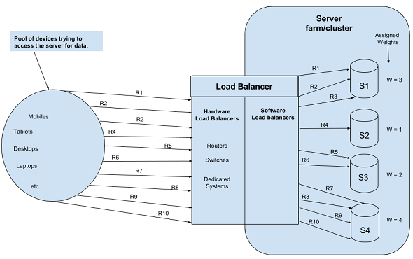
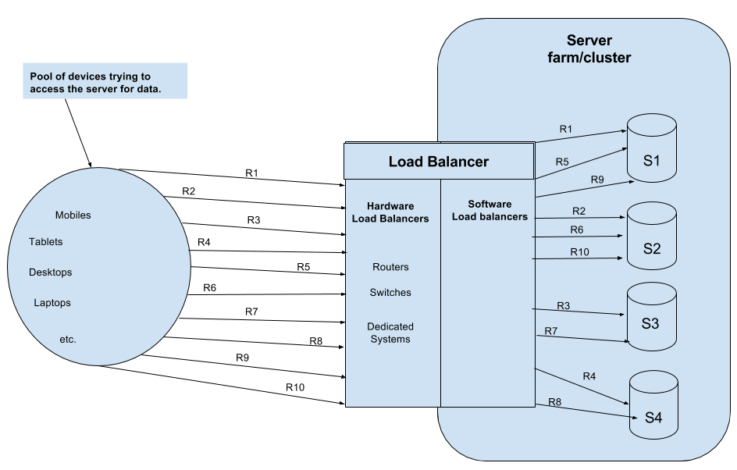
Weighted Scheduling
Round Robin

Slide 5
Hardware load balancers:
HW LBs are often referred to as specialized routers or switches which are deployed in between the servers and the client.
HW LBs are implemented on Layer4 (Transport layer) and Layer7(Application layer).

Slide 6
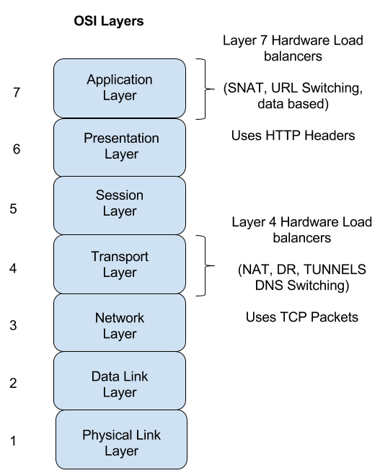
Layer 4:
Network address translators(NATs): shares load to different servers getting translated to by these LBs
DNS load balancing: Domain Name Servers are configured to return different ipaddress for different systems.

Slide 7
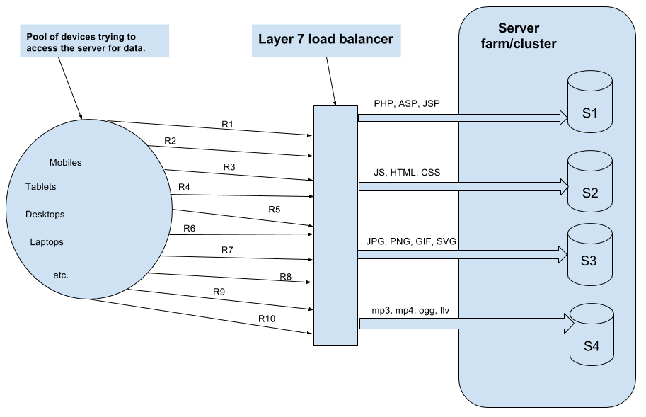
Layer 7: AND(Application delivery network)
Examples: CISCO system catalyst, Barracuda load balancer, Coytepoint load balancer

